Slide 1

Comparative Analysis of SVM and Neural Networks for Early Diabetes Detection
Machine Learning Classification for Diabetic Status Prediction
Presented by Vansh Kumar

Slide 2

Problem Statement: Early Diabetes Detection
The Challenge
Our Goal
Comparison
Diabetes Mellitus is a chronic disease requiring early diagnosis to prevent severe complications. Traditional diagnosis relies on specific blood tests (OGTT and HbA1c) which require clinical intervention.
Build a Machine Learning classifier to predict diabetic status based on clinical features.
Compare Linear SVM (linear model) vs Multi-Layer Perceptron (non-linear deep learning) to determine which architecture best handles medical data complexity.

Slide 3
Dataset Overview: Medical Records Analysis
Dataset Composition
Features & Classification
Total Patients: 1,065
Input Features (X): First 6 columns including demographics and physical indicators (Gender, Age, BMI)
Source: data_file.xlsx
Target Labels (y): Binary classification
Non-Diabetic (0): 537 samples (50.4%)
Labeling Logic: Diabetic if Glucose (OGTT) ≥ 126 OR Hemoglobin A1c ≥ 6.5
Diabetic (1): 528 samples (49.6%)
Balanced class distribution - ideal for training
Follows strict medical diagnostic thresholds

Slide 4
Exploratory Data Analysis: Key Insights
Balanced Class Distribution
Separability Issues
Dataset is remarkably balanced (~50.4% Non-Diabetic vs ~49.6% Diabetic). This is ideal for training as it prevents bias toward the majority class.
Performance metrics (~61% accuracy) suggest input features overlap significantly between classes. No clear linear boundary separates diabetic from non-diabetic patients based solely on physical traits.
Feature Scaling Necessity
Data Quality
Features like Age (20-80) and BMI (18-40) had vastly different scales, requiring StandardScaler normalization before feeding into models.
Clean, well-structured medical records with no missing values in key diagnostic features.

Slide 5
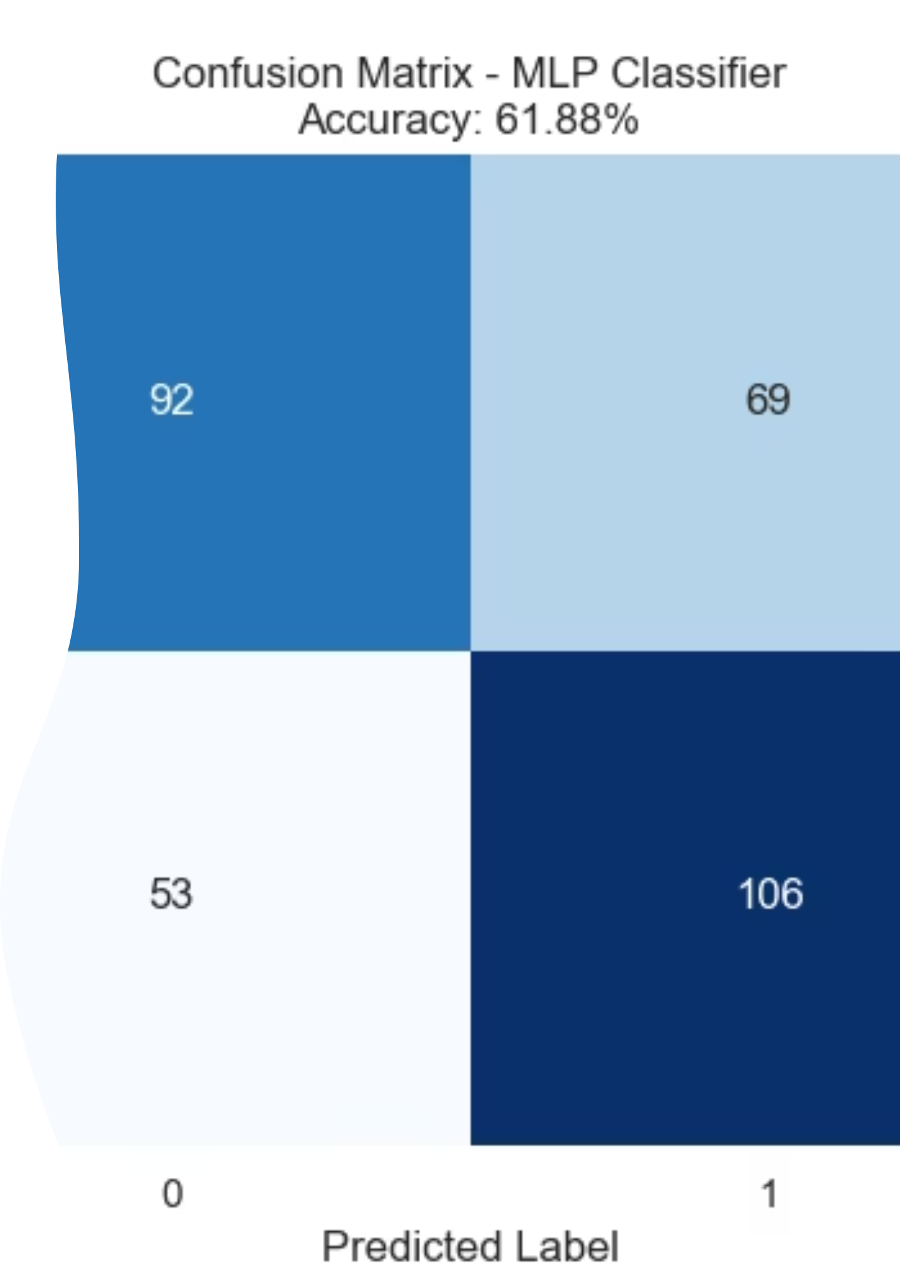
Confusion Matrix - MLP Classifier
Accuracy: 61.88%
True Negatives (Non-Diabetic correctly identified): 92
False Positives (Incorrectly classified as Diabetic): 69
False Negatives (Missed Diabetic cases): 53
True Positives (Diabetic correctly identified): 106
Conclusion: MLP performs better with fewer false negatives (53 vs 67), identifying 106 true diabetic cases compared to SVM's 92. Better for clinical early detection.

Slide 6
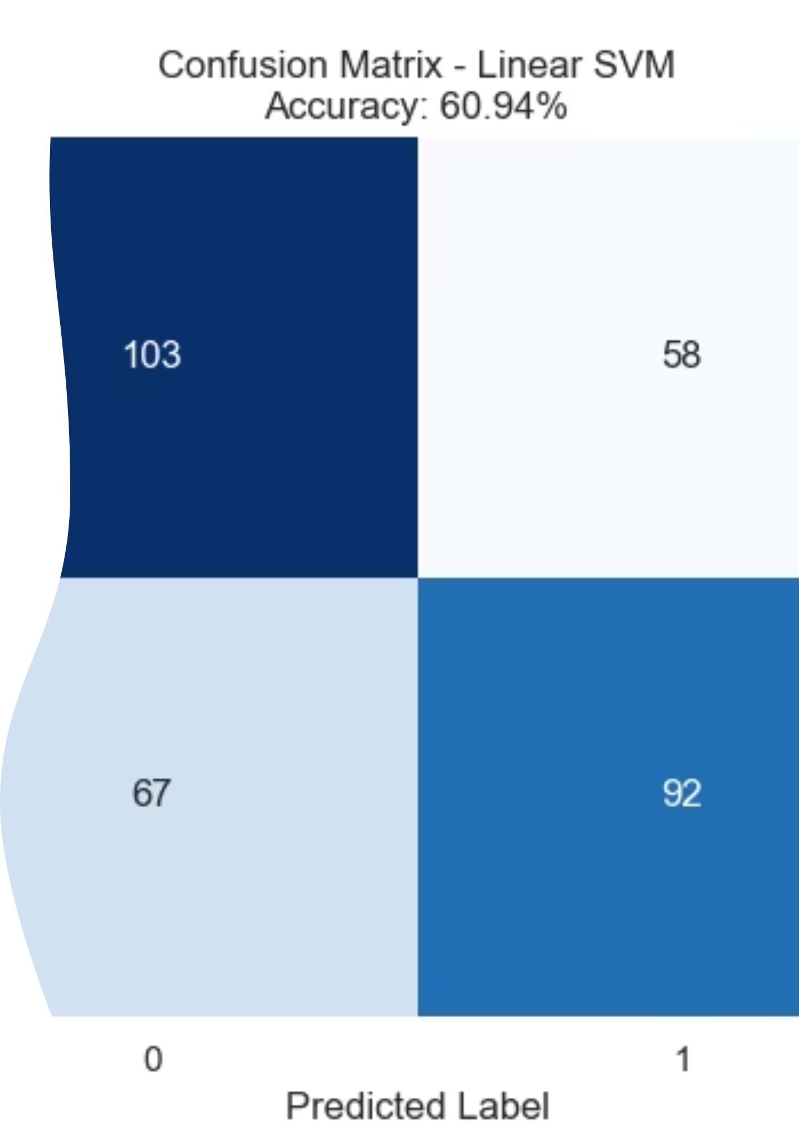
Confusion Matrix - Linear SVM
Accuracy: 60.94%
True Negatives (Non-Diabetic correctly identified): 103
False Positives (Incorrectly classified as Diabetic): 58
False Negatives (Missed Diabetic cases): 67
True Positives (Diabetic correctly identified): 92
Conclusion: High number of false negatives (67) indicates the linear model misses many actual diabetic patients, which is problematic for early detection.

Slide 7
Model Building: Algorithm Comparison
Linear Support Vector Machine (SVM)
Multi-Layer Perceptron (MLP - Neural Network)
Configuration: Optimized for regularization parameter C
Best Parameter: C = 0.01 (high regularization to prevent overfitting)
Configuration: Optimized for hidden layers, activation functions, solvers
Accuracy: 60.94%
Best Parameters: Activation = relu, Hidden Layers = (50,), Solver = sgd
Recall (Diabetic Class): 0.58
Key Finding: Linear kernel struggled to differentiate classes
Accuracy: 61.88%
Recall (Diabetic Class): 0.67
False Negatives: 67 missed diagnoses
Key Finding: MLP slightly outperformed SVM
True Positives: 106 diabetic patients correctly identified vs SVM's 92

Slide 8
Conclusions & Strategic Recommendations
Key Findings
Model Performance
Recommendations
Non-Linearity Wins: Neural Network (MLP) outperformed Linear SVM
Linear SVM: 60.94% accuracy, 0.58 recall
Feature Engineering: Add Blood Pressure, Family History, Insulin Levels
MLP: 61.88% accuracy, 0.67 recall
Confirms relationship between physical attributes and Diabetes is non-linear and complex
MLP identified 14 more true diabetic cases
Model Tuning: Switch MLP solver from sgd to adam for faster convergence
MLP reduced false negatives by 20%
Convergence Issues: MLP produced warnings, indicating SGD needed more iterations
Algorithm Selection: Test Kernel SVM (RBF) or ensemble methods (Random Forest/XGBoost)
Moderate Predictive Power: ~62% accuracy shows demographic features alone are insufficient
Next Steps: Implement non-linear models for better handling of tabular medical data

